Slide 1
20
Data Structures

Slide 2
Much that I bound, I could not free; Much that I freed returned to me.
  Lee Wilson Dodd
‘Will you walk a little faster?’ said a whiting to a snail,
‘There’s a porpoise close behind us, and he’s treading on my tail.’
  Lewis Carroll
There is always room at the top.
  Daniel Webster
Push on — keep moving.
  Thomas Morton
I’ll turn over a new leaf.
  Miguel de Cervantes

Slide 3
OBJECTIVES
In this chapter you’ll learn:
To form linked data structures using pointers, self-referential classes and recursion.
To create and manipulate dynamic data structures such as linked lists, queues, stacks and binary trees.
To use binary search trees for high-speed searching and sorting.
To understand various important applications of linked data structures.
To understand how to create reusable data structures with class templates, inheritance and composition.

Slide 4
20.1 Introduction
20.2 Self-Referential Classes
20.3 Dynamic Memory Allocation and Data Structures
20.4 Linked Lists
20.5 Stacks
20.6 Queues
20.7 Trees
20.8 Wrap-Up

Slide 5
20.1 Introduction
Dynamic data structures
  Grow and shrink during execution
  Linked lists
    Collections of data items “lined up in a row”
    Insertions and removals are made anywhere
  Stacks
    Insertions and removals are made only at top
    Important in compilers and operating systems
  Queues
    Insertions are made at back, removals are made at front
    Represent waiting lines

Slide 6
20.1 Introduction (Cont.)
Dynamic data structures (Cont.)
  Binary trees
    Facilitate
      High-speed searching and sorting
      Elimination of duplicates
    Used in
      Representations of file system directories
      Compilation of expressions into machine language

Slide 7
20.2 Self-Referential Classes
Self-referential class
  Contains a pointer member that points to an object of the same class type
  Example
    Class Node
    {
    …
    Node *nextPtr;
    };
  Pointer data member nextPtr is a link
    Can tie a Node to another Node

Slide 8

Fig. 20.1 | Two self-referential class objects linked together.

Slide 9
Common Programming Error 20.1
Not setting the link in the last node of a linked data structure to null (0) is a (possibly fatal) logic error.

Slide 10
20.3 Dynamic Memory Allocation and Data Structures
Dynamic memory allocation
  Obtain more memory at execution time
    Can be released when it is no longer needed
  Limited by amount of physical or virtual memory
    Memory must be shared among many programs

Slide 11
20.3 Dynamic Memory Allocation and Data Structures (Cont.)
new operator
  Dynamically allocates memory for an object
  Takes as argument the type of the object being allocated
  Returns pointer to the newly-allocated object
  Example
    Node *newPtr = new Node( 10 );
      Allocates sizeof( Node ) bytes for new Node object
      Calls Node constructor with argument 10
      Assigns address of new Node object to newPtr

Slide 12
20.3 Dynamic Memory Allocation and Data Structures (Cont.)
delete operator
  Calls the destructor and deallocates memory for an object
  Example
    delete newPtr;
      Calls Node destructor for object pointed to by newPtr
      Deallocates memory of object pointed to by newPtr
      Does not delete pointer variable newPtr
  If called on a null pointer, has no effect

Slide 13
20.4 Linked Lists
Linked list
  Linear collection of self-referential class objects
    Called nodes
    Connected by pointer links
  Accessed via a pointer to the first node
    Subsequent nodes are accessed via previous node’s link
  By convention, link in last node is set to null pointer 0
  Additional nodes are dynamically allocated as necessary

Slide 14
20.4 Linked Lists (Cont.)
Linked list (Cont.)
  Advantages over arrays
    Linked lists are dynamic
      Length can increase or decrease as necessary
    Efficient insertion of new elements into a sorted list
      Existing list elements do not need to be moved

Slide 15
Performance Tip 20.1
An array can be declared to contain more elements than the number of items expected, but this can waste memory. Linked lists can provide better memory utilization in these situations. Linked lists allow the program to adapt at runtime. Note that class template vector (introduced in Section 7.11) implements a dynamically resizable array-based data structure.

Slide 16
Performance Tip 20.2
Insertion and deletion in a sorted array can be time consuming—all the elements following the inserted or deleted element must be shifted appropriately. A linked list allows efficient insertion operations anywhere in the list.

Slide 17
Performance Tip 20.3
The elements of an array are stored contiguously in memory. This allows immediate access to any array element, because the address of any element can be calculated directly based on its position relative to the beginning of the array. Linked lists do not afford such immediate “direct access” to their elements. So accessing individual elements in a linked list can be considerably more expensive than accessing individual elements in an array. The selection of a data structure is typically based on the performance of specific operations used by a program and the order in which the data items are maintained in the data structure. For example, it is typically more efficient to insert an item in a sorted linked list than a sorted array.

Slide 18
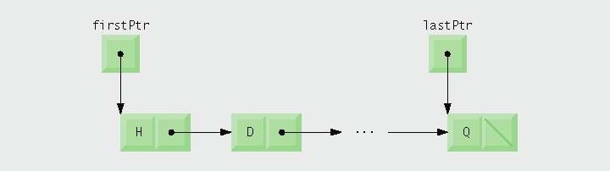
Fig. 20.2 | A graphical representation of a list.

Slide 19
Performance Tip 20.4
Using dynamic memory allocation (instead of fixed-size arrays) for data structures that grow and shrink at execution time can save memory. Keep in mind, however, that pointers occupy space and that dynamic memory allocation incurs the overhead of function calls.

Slide 20
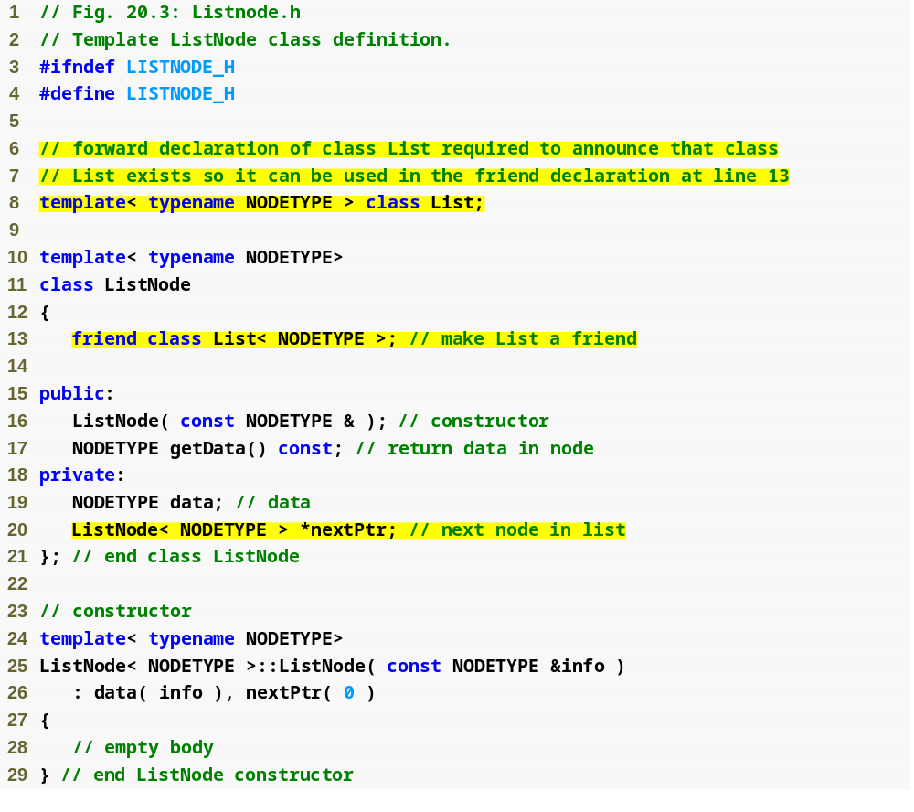
Outline
Listnode.h
(1 of 2)
Declare class List< NODETYPE > as a friend
Member data stores a value of type parameter NODETYPE
Member nextPtr stores a pointer to the next ListNode object in the linked list

Slide 21
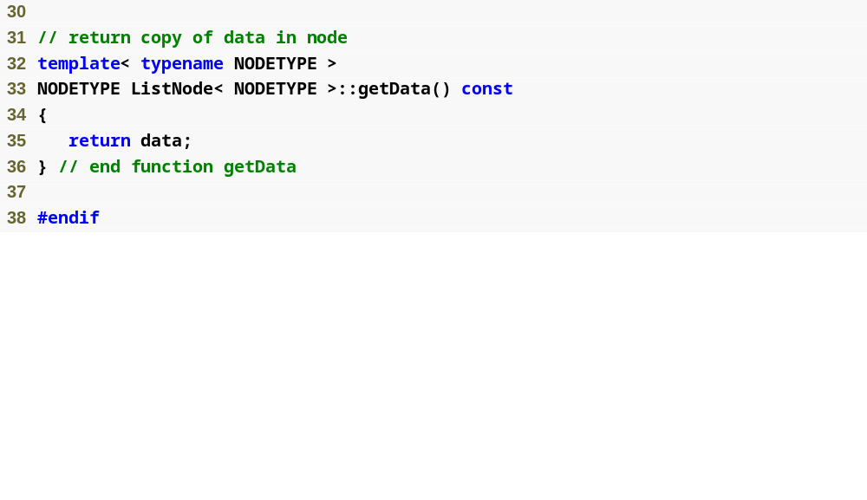
Outline
Listnode.h
(2 of 2)

Slide 22
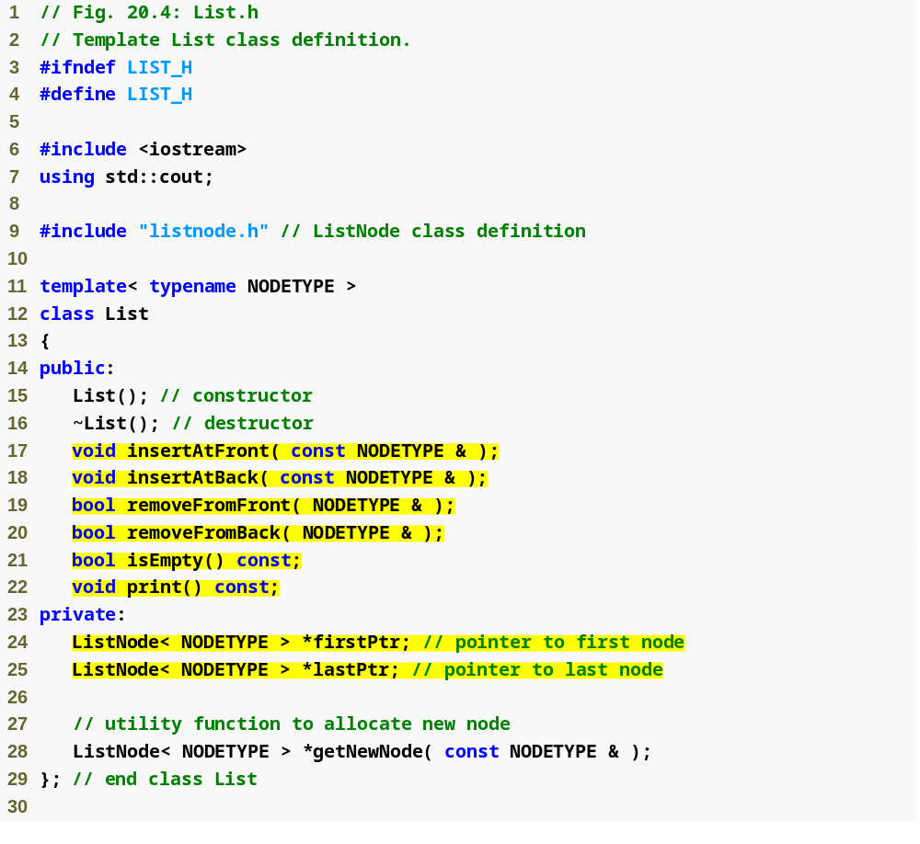
Outline
List.h
(1 of 7)
private data members firsrtPtr (a pointer to the first ListNode in a List) and lastPtr (a pointer to the last ListNode in a List)

Slide 23
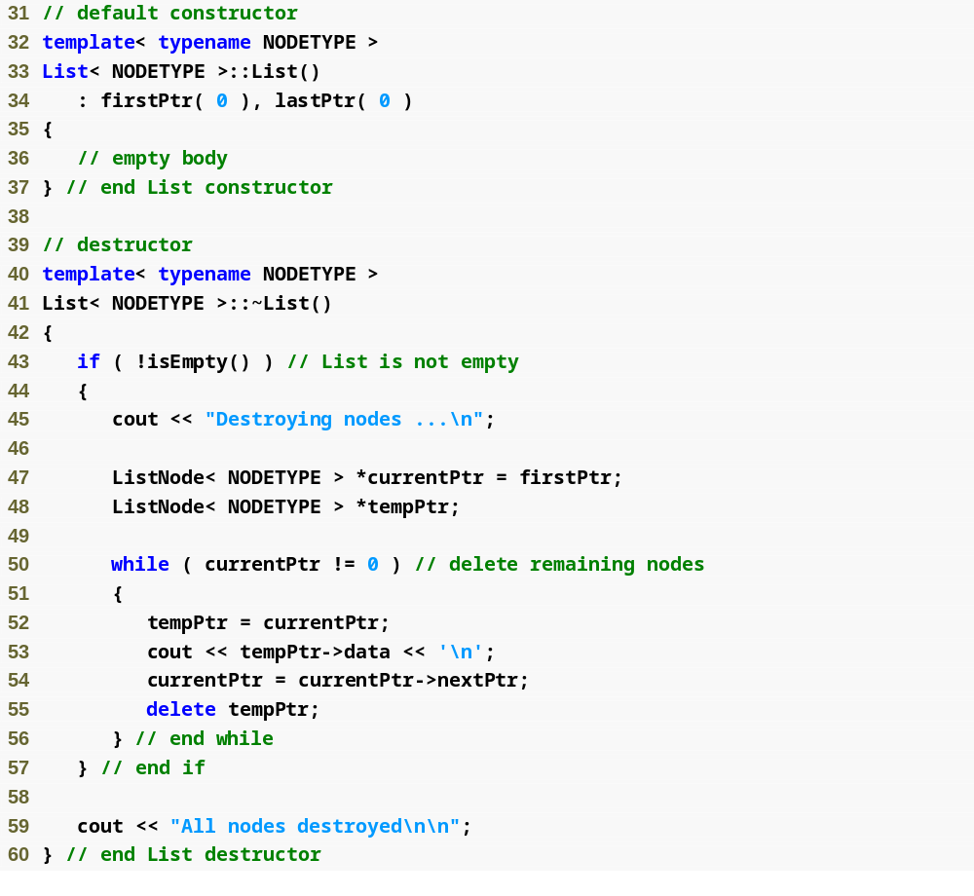
Outline
Initialize both pointers to 0 (null)
List.h
(2 of 7)
Ensure that all ListNode objects in a List object are destroyed when that List object is destroyed

Slide 24
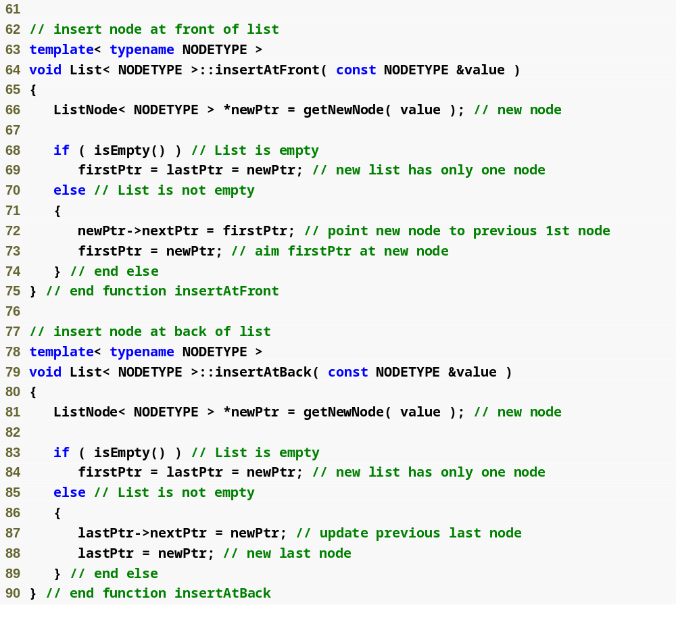
Places a new node at the front of the list
Outline
Use function getNewNode to allocate a new ListNode containing value and assign it to newPtr
List.h
(3 of 7)
If the list is empty, then both firstPtr and lastPtr are set to newPtr
Thread the new node into the list so that the new node points to the old first node and firstPtr points to the new node
Places a new node at the back of the list
Use function getNewNode to allocate a new listNode containing value and assign it to newPtr
If the list is empty, then both firstPtr and lastPtr are set to newPtr
Thread the new node into the list so that the old last node points to the new node and lastPtr points to the new node

Slide 25
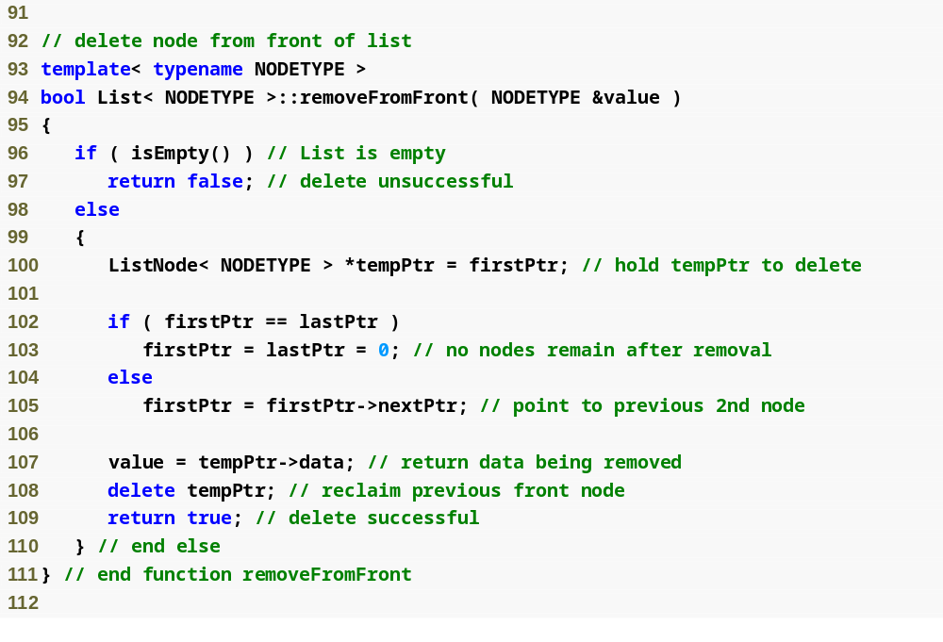
Removes the front node of the list and copies the node value to the reference parameter
Outline
Return false if an attempt is made to remove a node from an empty list
List.h
(4 of 7)
Save a pointer to the first node, which will be removed
If the list has only one element, leave the list empty
Set firstPtr to point to the second node (the new first node)
Copy the removed node’s data to reference parameter value
delete the removed node

Slide 26
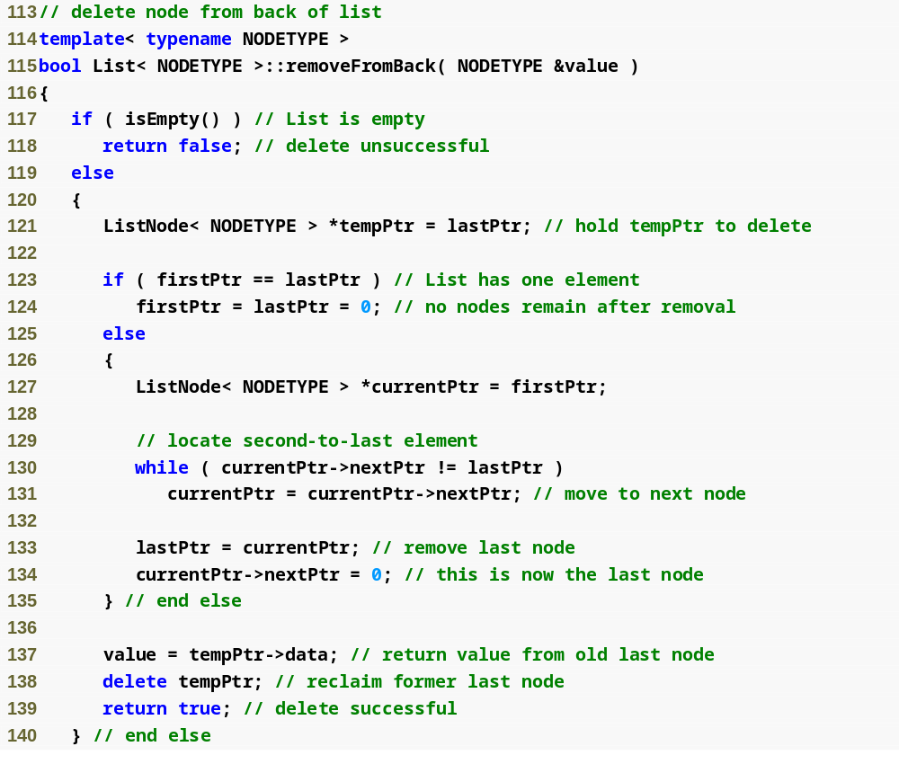
Removes the back node of the list and copies the node value to the reference parameter
Outline
Return false if an attempt is made to remove a node from an empty list
List.h
(5 of 7)
Save a pointer to the last node, which will be removed
If the list has only one element, leave the list empty
Assign currentPtr the address of the first node to prepare to “walk the list”
“Walk the list” until currentPtr points to the node before the last node, which will be the new last node
Make the currentPtr node the new last node
Copy the removed node’s data to reference parameter value
delete the removed node

Slide 27
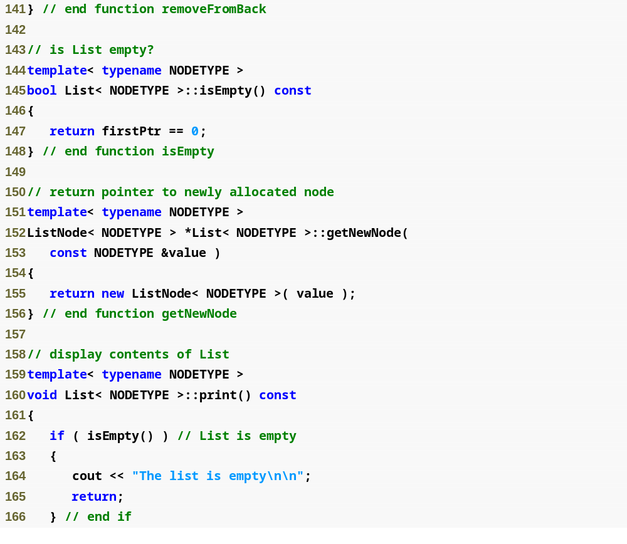
Outline
Determine whether the List is empty
List.h
(6 of 7)
Return a dynamically allocated ListNode object

Slide 28
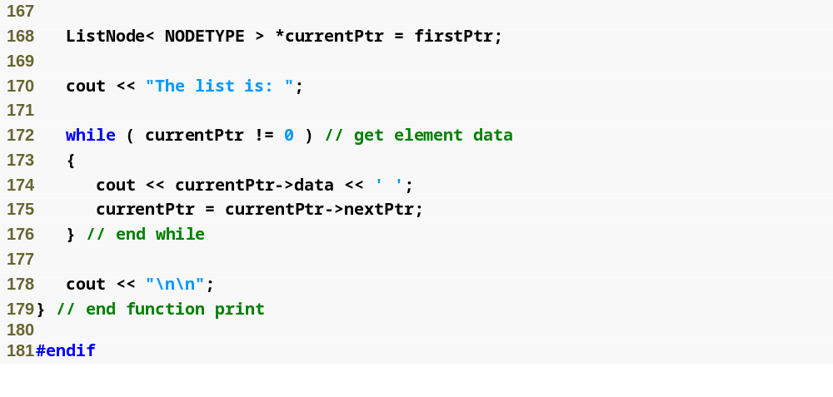
Outline
List.h
(7 of 7)
Iterate through the list and output the value in each node

Slide 29
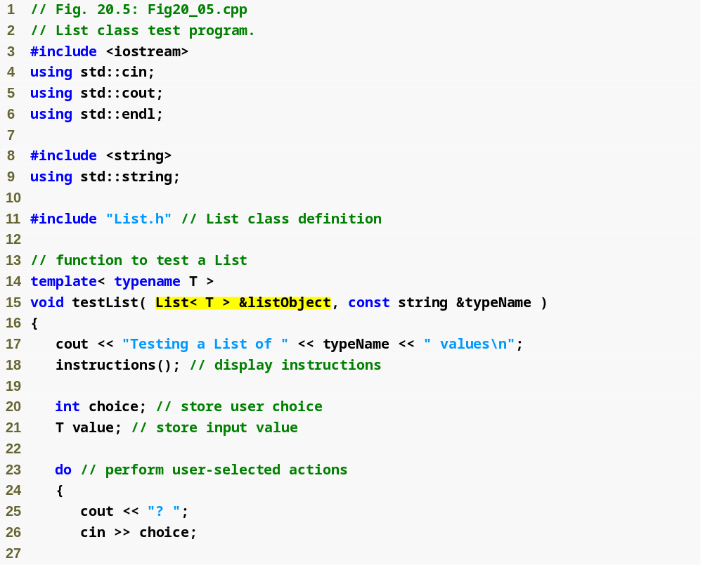
Outline
Fig20_05.cpp
(1 of 6)

Slide 30
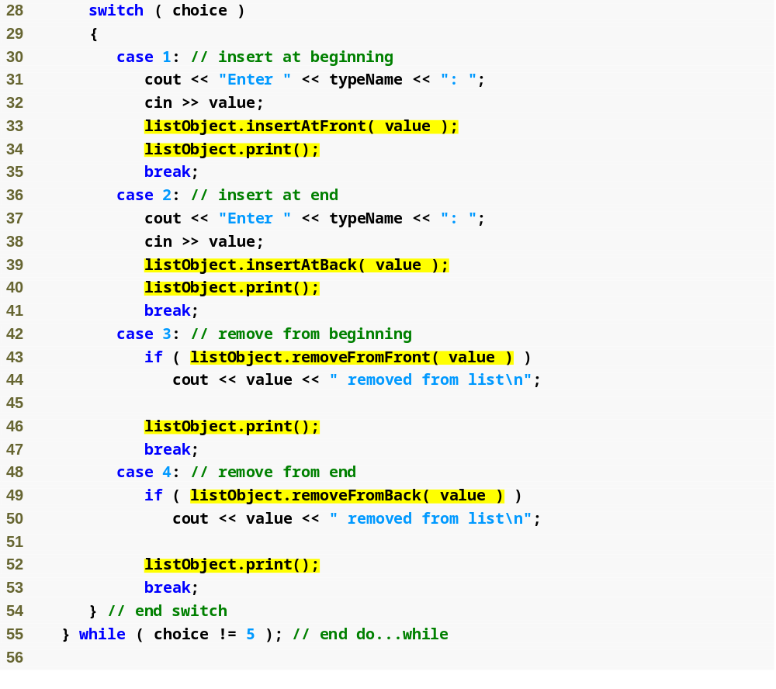
Outline
Fig20_05.cpp
(2 of 6)

Slide 31
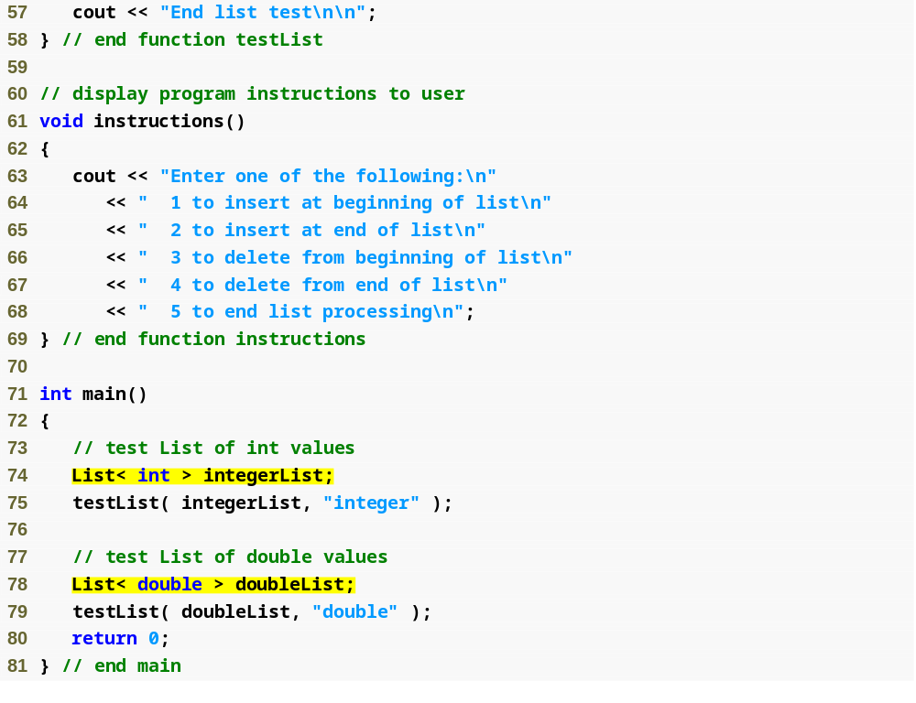
Outline
Fig20_05.cpp
(3 of 6)

Slide 32
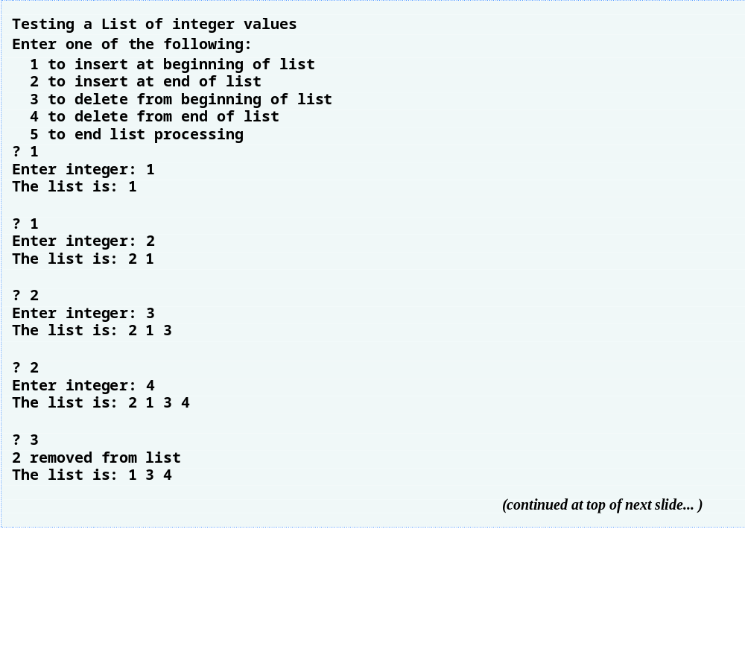
Outline
Fig20_05.cpp
(4 of 6)

Slide 33
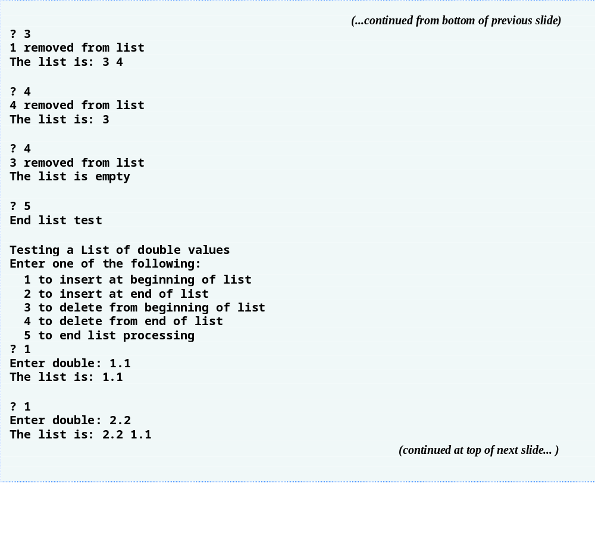
Outline
Fig20_05.cpp
(5 of 6)

Slide 34
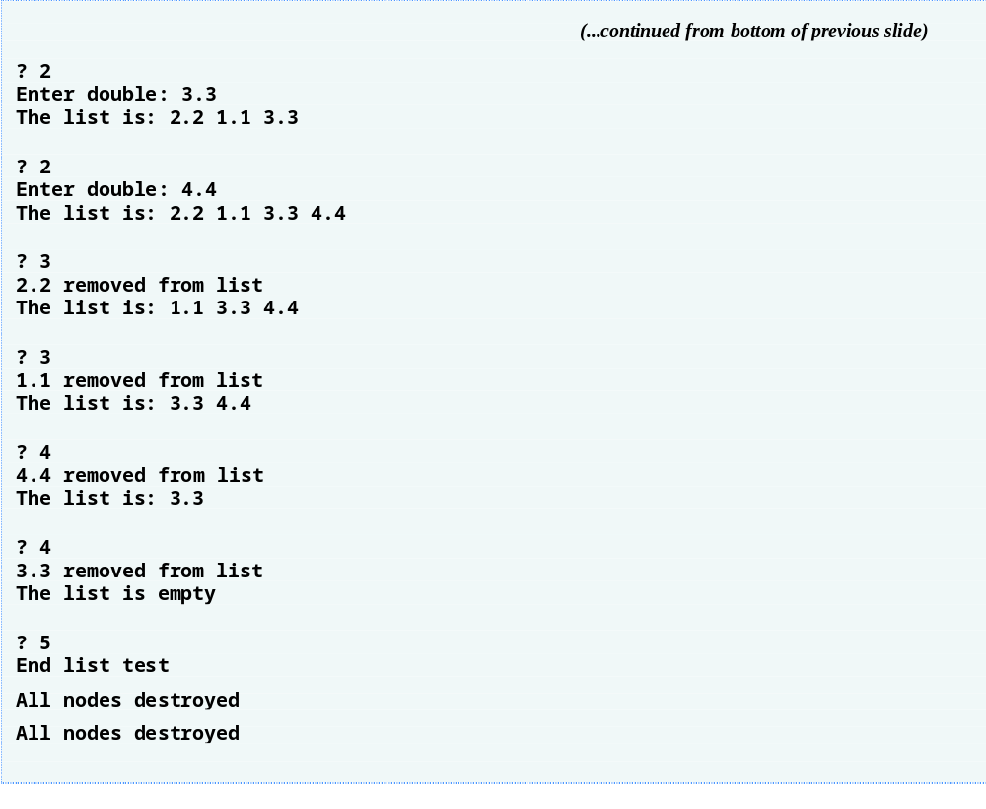
Outline
Fig20_05.cpp
(6 of 6)

Slide 35
Error-Prevention Tip 20.1
Assign null (0) to the link member of a new node. Pointers should be initialized before they are used.

Slide 36
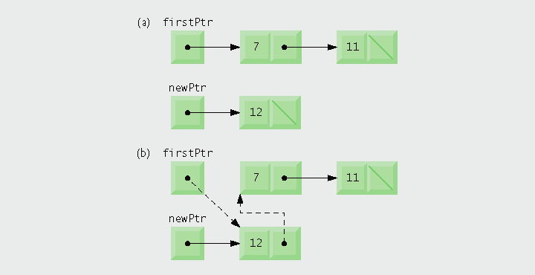
Fig. 20.6 | Operation insertAtFront represented graphically.

Slide 37
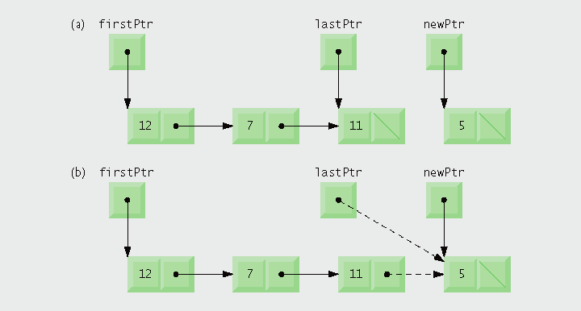
Fig. 20.7 | Operation insertAtBack represented graphically.

Slide 38
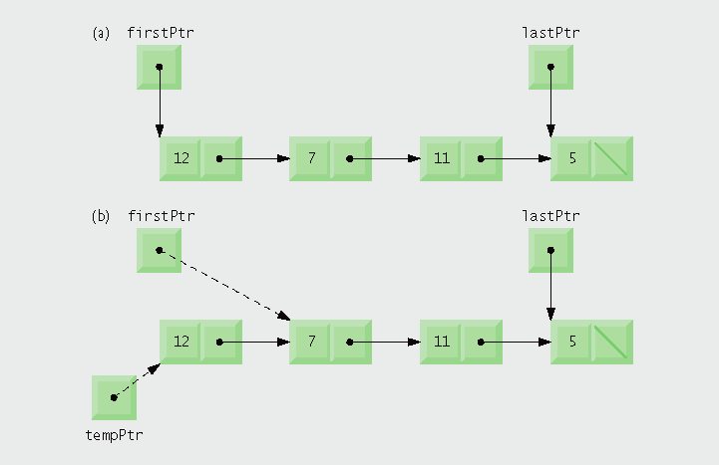
Fig. 20.8 | Operation removeFromFront represented graphically.

Slide 39
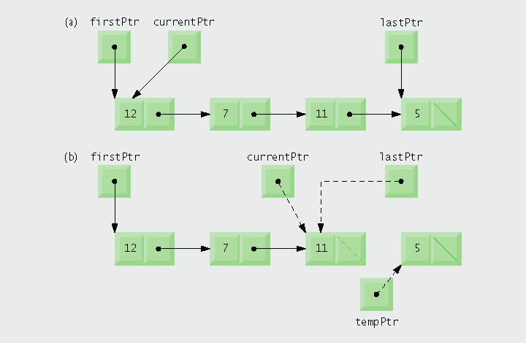
Fig. 20.9 | Operation removeFromBack represented graphically.

Slide 40
20.4 Linked Lists (Cont.)
Linked list (Cont.)
  Circular, singly linked list
    Pointer in last node points back to first node
  Doubly linked list
    Each node has a link to next node and a link to previous node
    Two “start pointers”
      One to first node, one to last node
    Allows traversals both forward and backward
  Circular, doubly linked list
    Forward link of last node points back to first node
    Backward link of first node points to last node

Slide 41
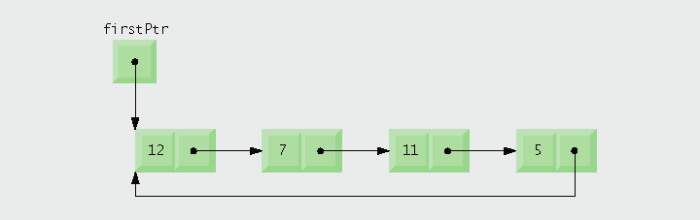
Fig. 20.10 | Circular, singly linked list.

Slide 42
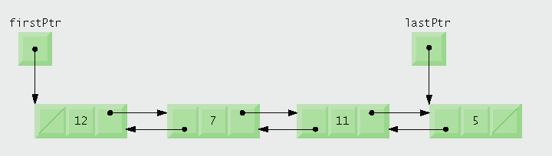
Fig. 20.11 | Doubly linked list.

Slide 43
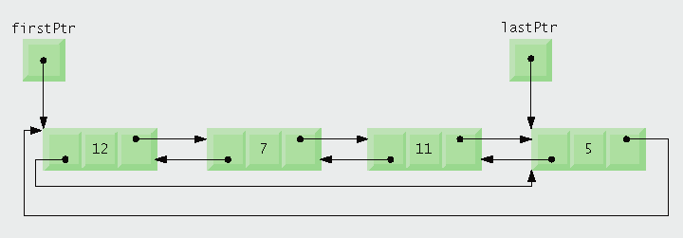
Fig. 20.12 | Circular, doubly linked list.

Slide 44
20.5 Stacks
Stack
  Allows nodes to be added and removed only at the top
    Referred to as a last-in, first-out (LIFO) data structure
  Can be implemented as a constrained linked list
    Link of the last node of the stack is set to null to indicate bottom of the stack
  Manipulated using member functions push and pop
    push inserts new node at the top
    pop removes node from the top and retrieves its value

Slide 45
20.5 Stacks (Cont.)
Stack (Cont.)
  Applications of stacks
    Function call stack
      Stores return addresses for function calls
      Stores values of automatic variables in function calls
    Used by compilers
      Evaluating expressions
      Generating machine-language code

Slide 46
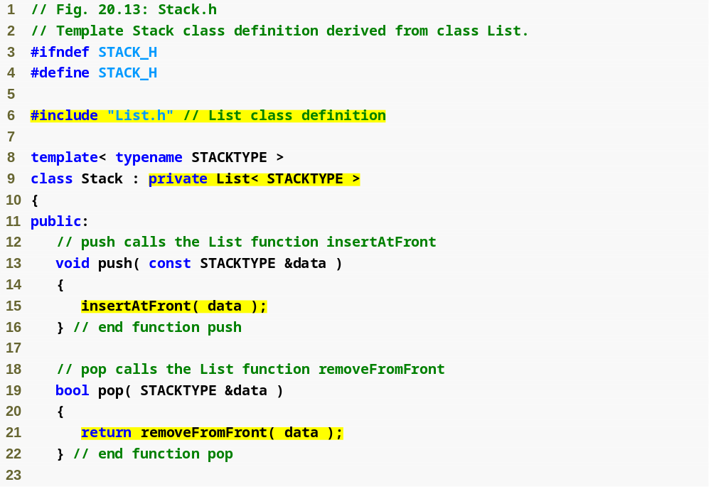
Outline
Stack.h
(1 of 2)
Create a Stack class template through private inheritance of the List class template
Perform push and pop by delegating to base-class member functions insertAtFront and removeFromFront, respectively

Slide 47
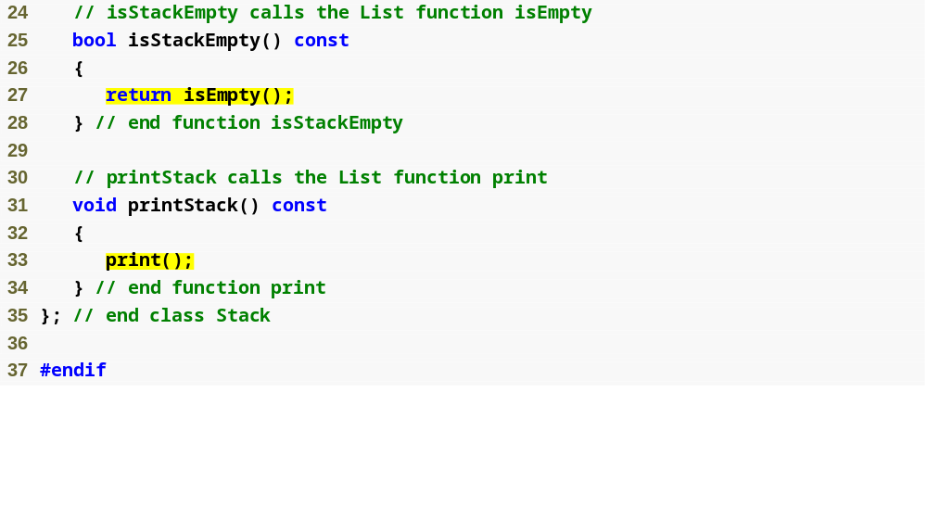
Outline
Member functions isStackEmpty and printStack delegate to base-class member functions isEmpty and print, respectively
Stack.h
(2 of 2)

Slide 48
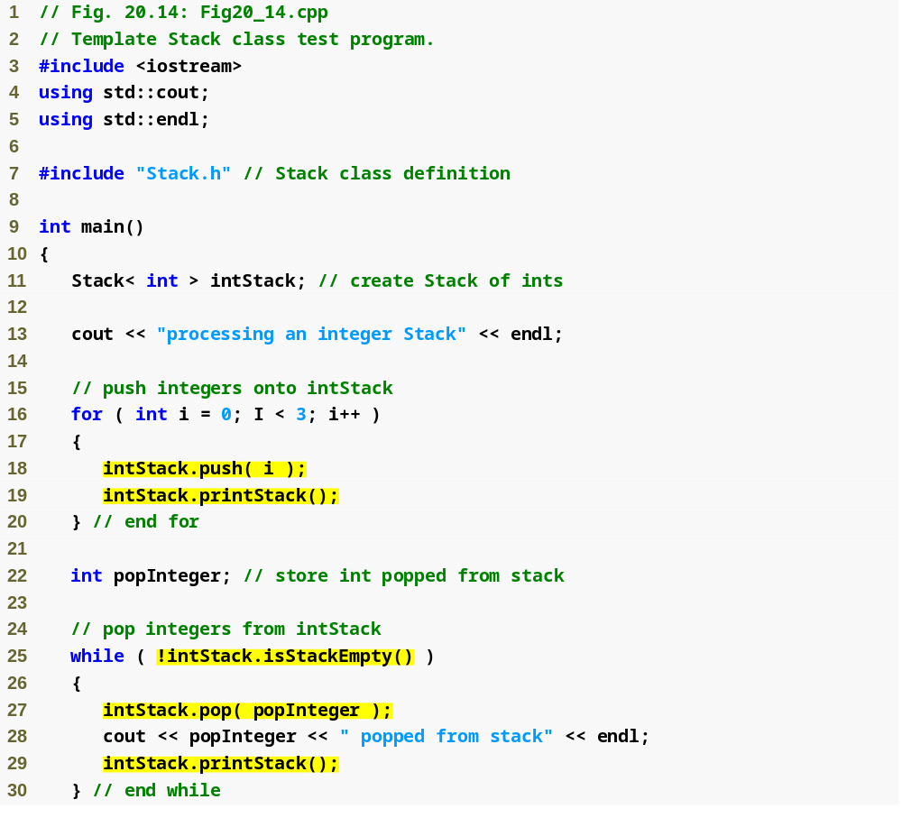
Outline
Fig20_14.cpp
(1 of 3)
Push integers 0 through 2 onto intStack
Pop integers 2 through 0 off intStack

Slide 49
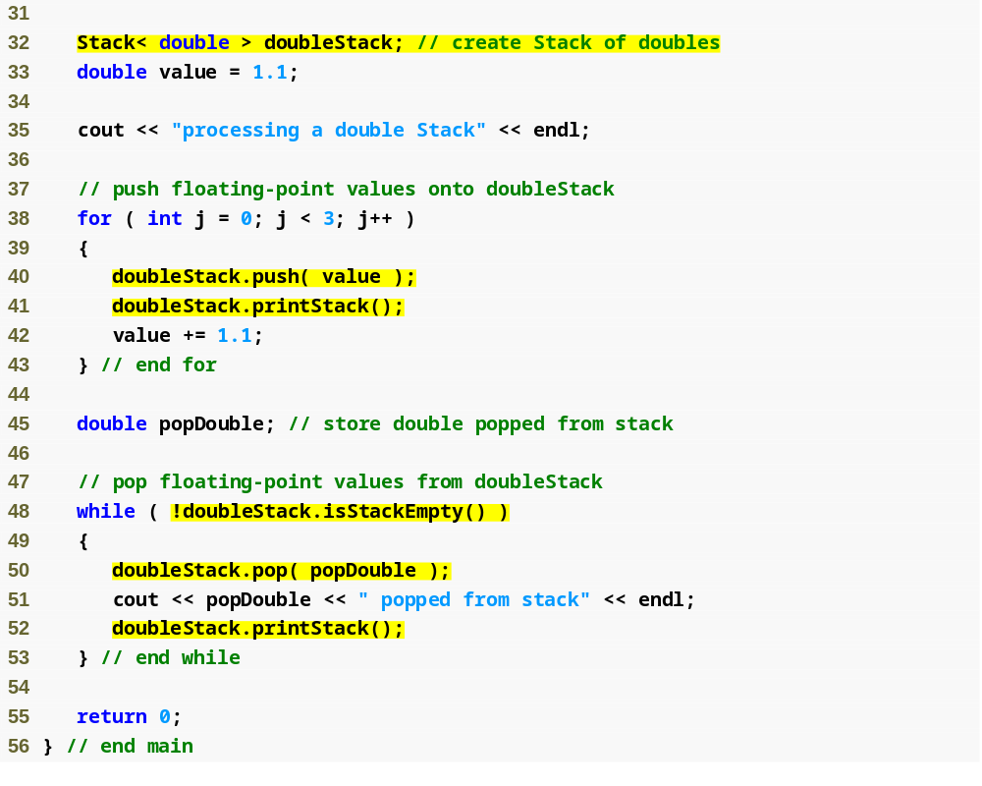
Outline
Fig20_14.cpp
(2 of 3)
Push values 1.1, 2.2 and 3.3 onto doubleStack
Pop values 3.3, 2.2 and 1.1 off doubleStack

Slide 50
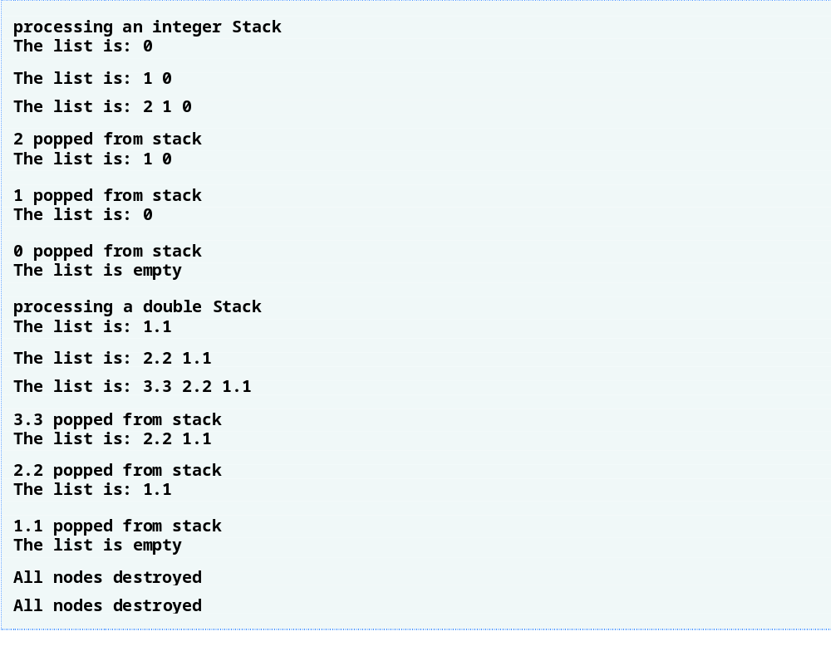
Outline
Fig20_14.cpp
(3 of 3)

Slide 51
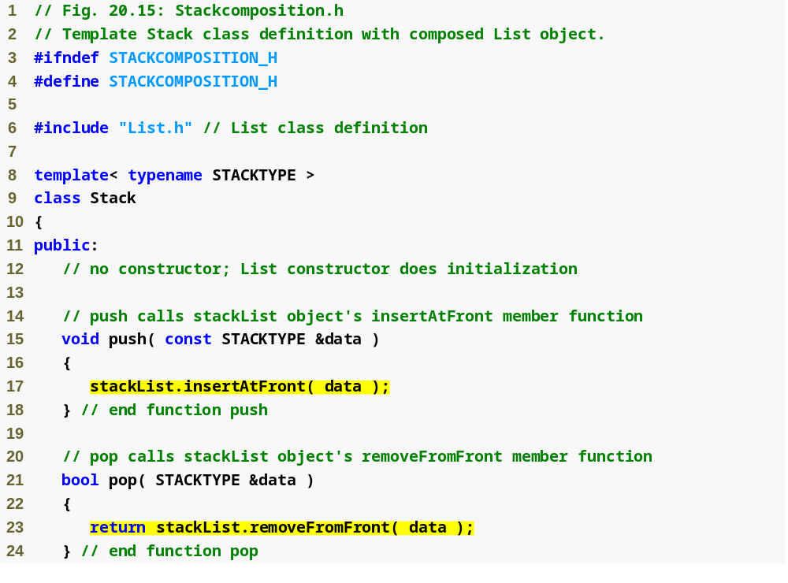
Outline
Stack
composition.h
(1 of 2)

Slide 52
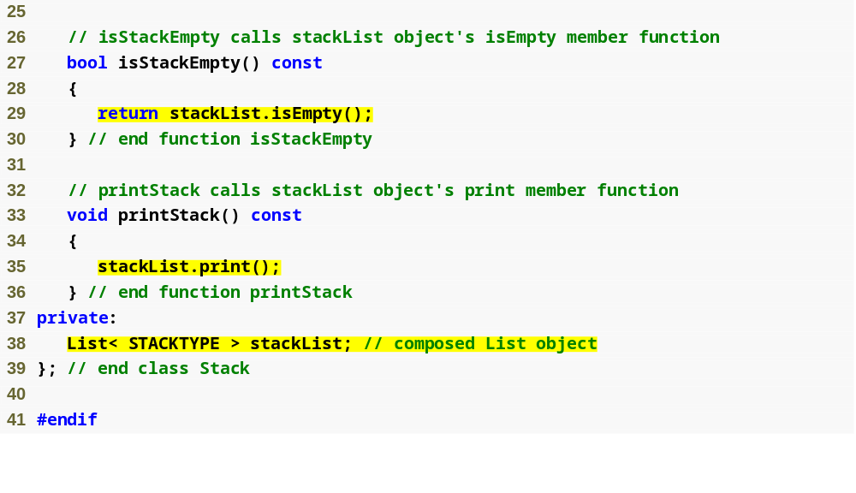
Outline
Stack
composition.h
(2 of 2)
This implementation of the Stack class template contains a List< STACKTYPE > object called stackList

Slide 53
20.6 Queues
Queue
  First item in line is serviced first, others wait in line
    Nodes removed only from head and inserted only at tail
    Referred to as a first-in, first-out (FIFO) data structure
  Insert and remove operations are enqueue and dequeue
  Applications of queues
    Waiting lines for
      Processor usage
      Printing jobs
      Packets at a router
      File system requests

Slide 54
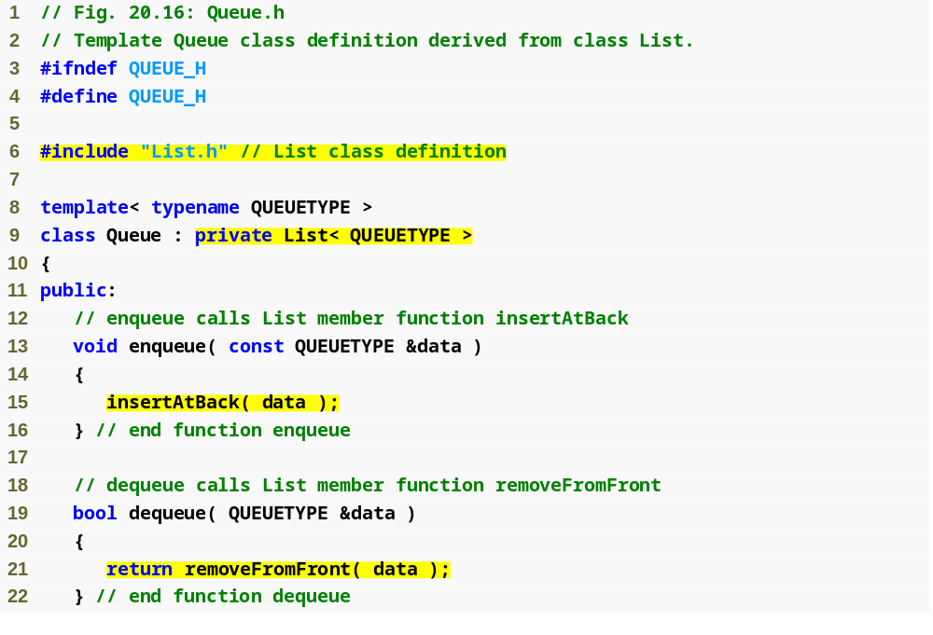
Outline
Queue.h
(1 of 2)
Create a Queue class template through private inheritance of the List class template
Perform enqueue and dequeue by delegating to base-class member functions insertAtBack and removeFromFront, respectively

Slide 55
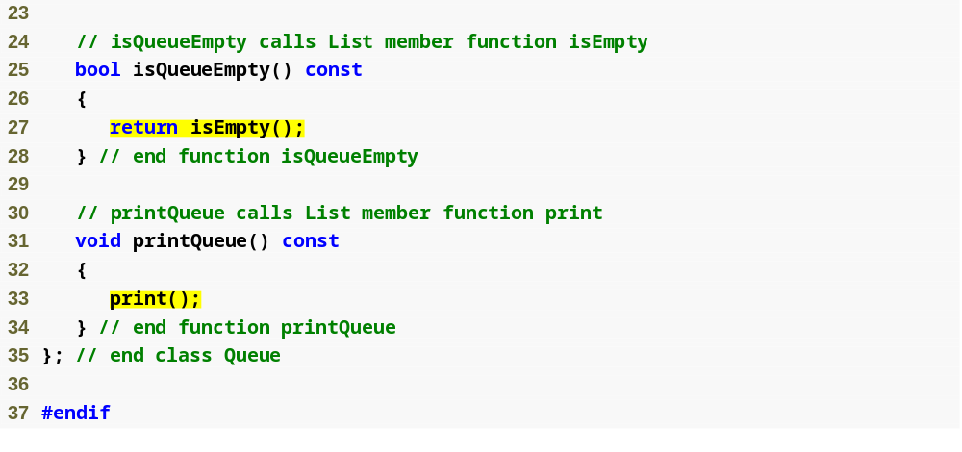
Outline
Queue.h
(2 of 2)
Member functions isQueueEmpty and printQueue delegate to base-class member functions isEmpty and print, respectively

Slide 56
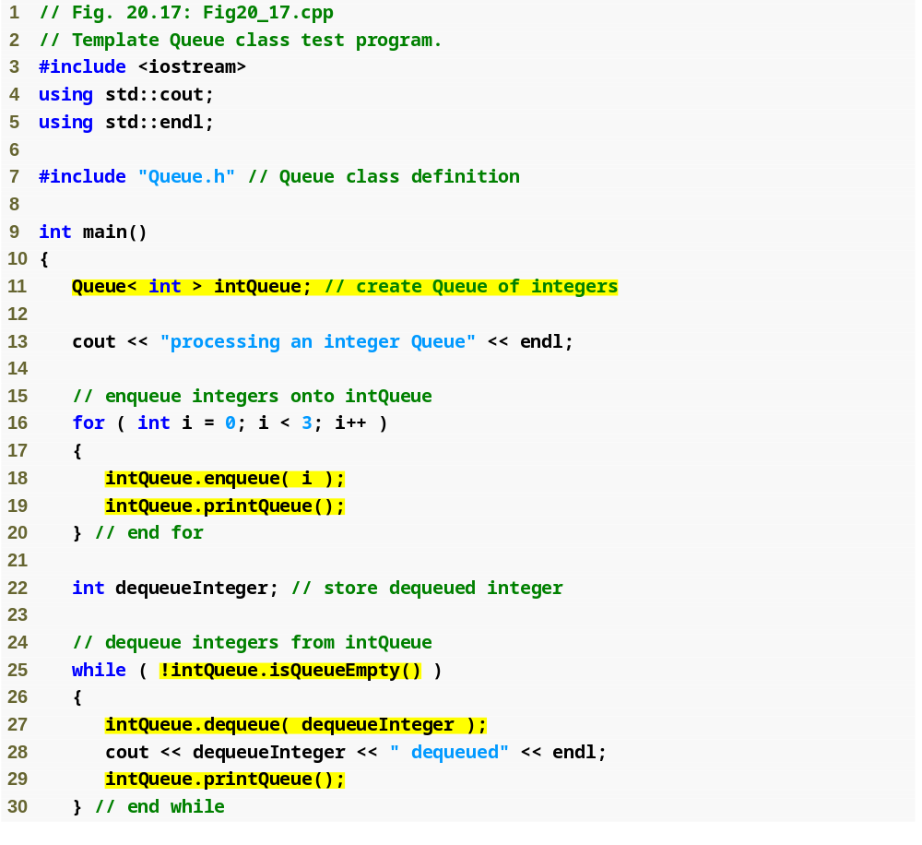
Outline
Fig20_17.cpp
(1 of 3)
Enqueue integers 0 through 2 to intQueue
Dequeue integers 0 through 2 from intQueue

Slide 57
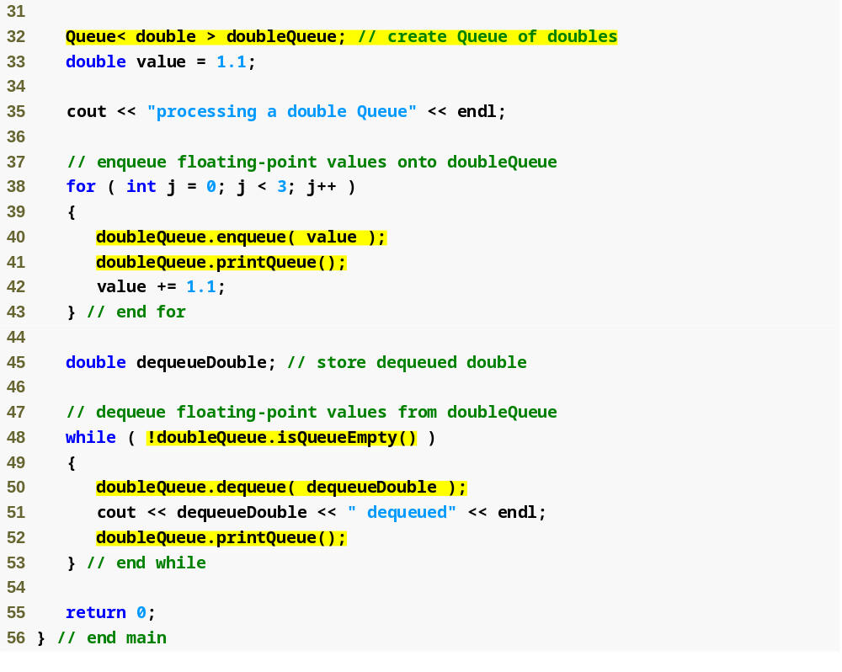
Outline
Fig20_17.cpp
(2 of 3)
Enqueue values 1.1, 2.2 and 3.3 to doubleQueue
Dequeue values 1.1, 2.2 and 3.3 from doubleQueue

Slide 58
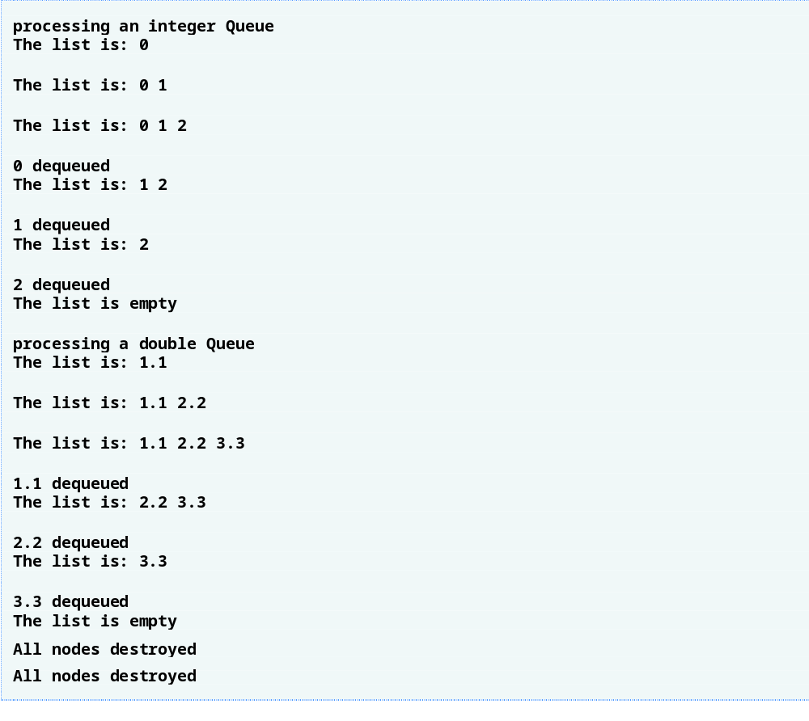
Outline
Fig20_17.cpp
(2 of 3)

Slide 59
20.7 Trees
Tree
  Nonlinear, two-dimensional data structure
  Tree nodes contain two or more links
    Binary tree nodes contain exactly two links

Slide 60
20.7 Trees (Cont.)
Tree (Cont.)
  Terminology
    Root node
      First node in a tree
    Child node
      Node linked to by another node (its parent)
      In a binary tree, there is a left child and a right child
    Subtree
      Tree defined by treating a child node as the root of its own tree
    Siblings
      Multiple children of a single parent node
    Leaf node
      Node with no children

Slide 61
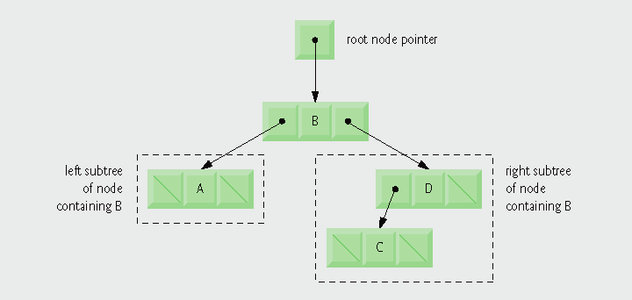
Fig. 20.18 | A graphical representation of a binary tree.

Slide 62
20.7 Trees (Cont.)
Tree (Cont.)
  Binary search tree
    Values in any left subtree are less than value in its parent node
    Values in any right subtree are greater than value in its parent node
    Can be recursively traversed in three ways
      Inorder
        Left subtree, then current node, then right subtree
      Preorder
        Current node, then left subtree, then right subtree
      Postorder
        Left subtree, then right subtree, then current node

Slide 63

Fig. 20.19 | A binary search tree.

Slide 64
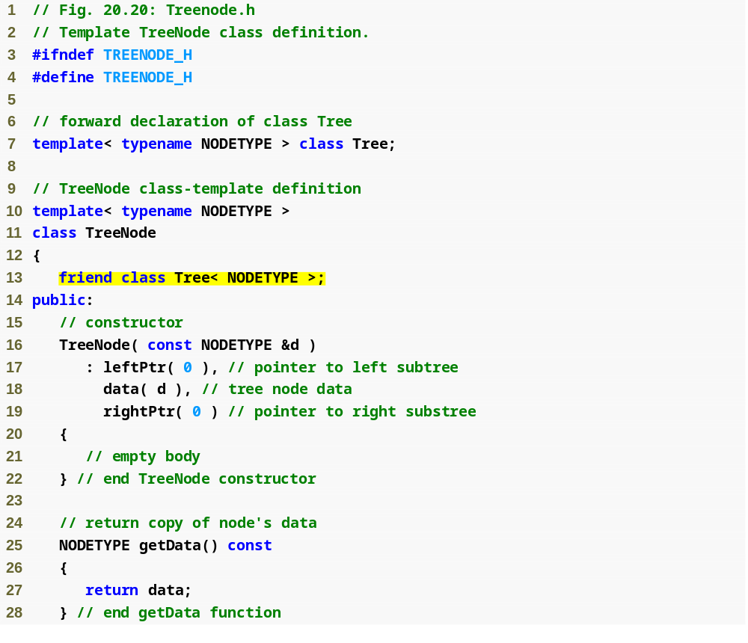
Outline
Treenode.h
(1 of 2)
Declare Tree< NODETYPE > as TreeNode< NODETYPE >’s friend
Initialize this node to be a leaf node with data value d

Slide 65
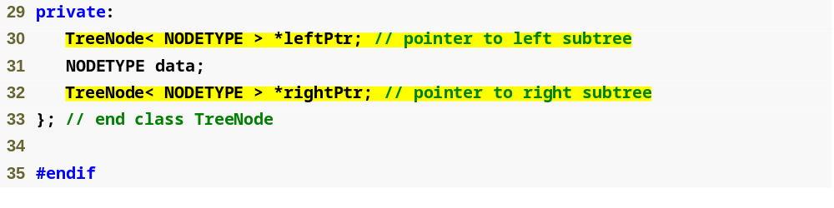
Outline
Treenode.h
(2 of 2)
Pointers leftPtr and rightPtr point to the node’s left and right subtrees, respectively

Slide 66
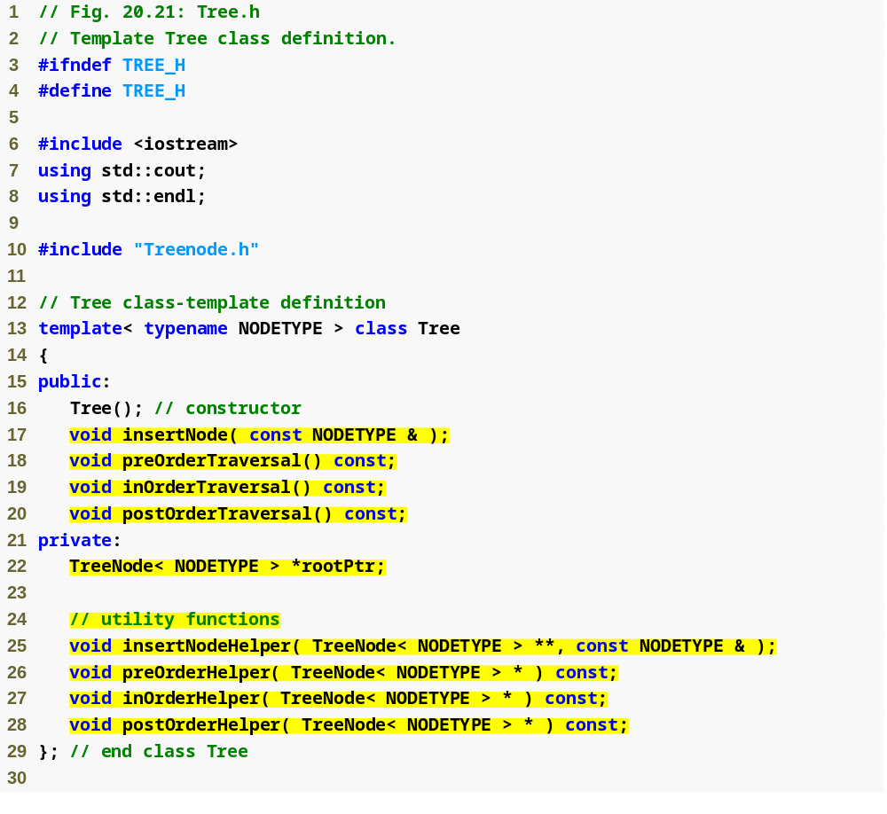
Outline
Tree.h
(1 of 6)

Slide 67
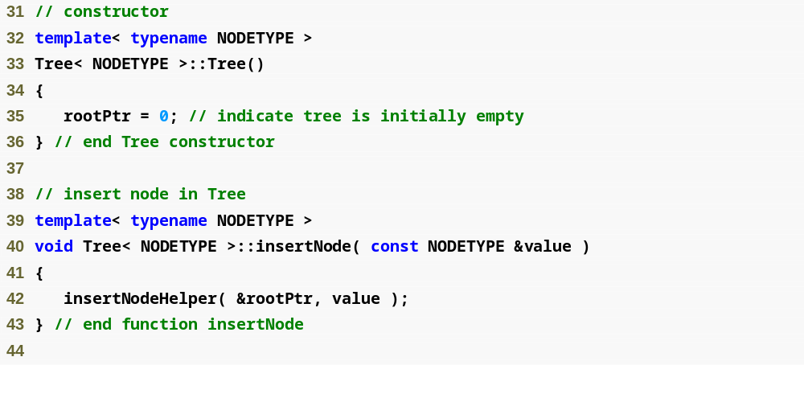
Initialize rootPtr to zero to indicate that the tree is initially empty
Outline
Tree.h
(2 of 6)
Call utility function insertNodeHelper to recursively insert a node into the tree

Slide 68
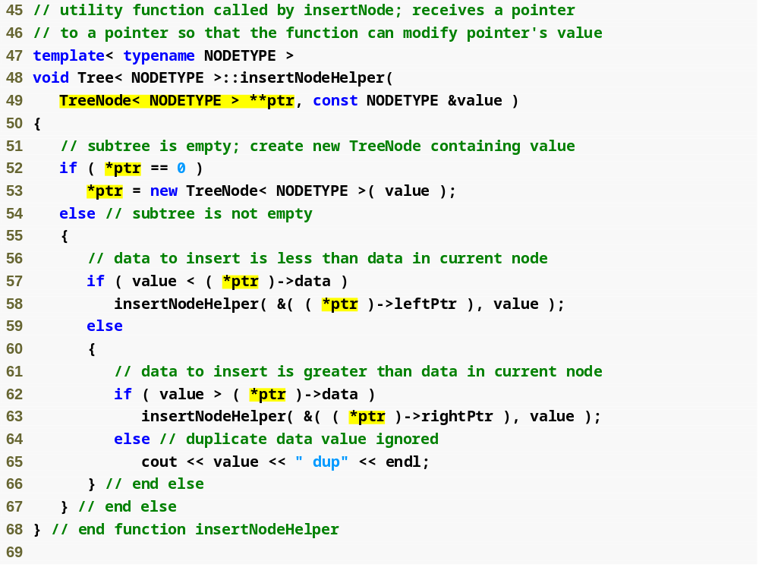
Outline
Parameter ptr is a pointer to a pointer to a TreeNode
Tree.h
(3 of 6)
A new TreeNode is created, initialized and inserted in the tree
Recursively call insertNodeHelper with the address of the pointer to the appropriate binary search subtree
If the value to be inserted is identical to the data value in the root node, do not insert the duplicate value into the tree

Slide 69
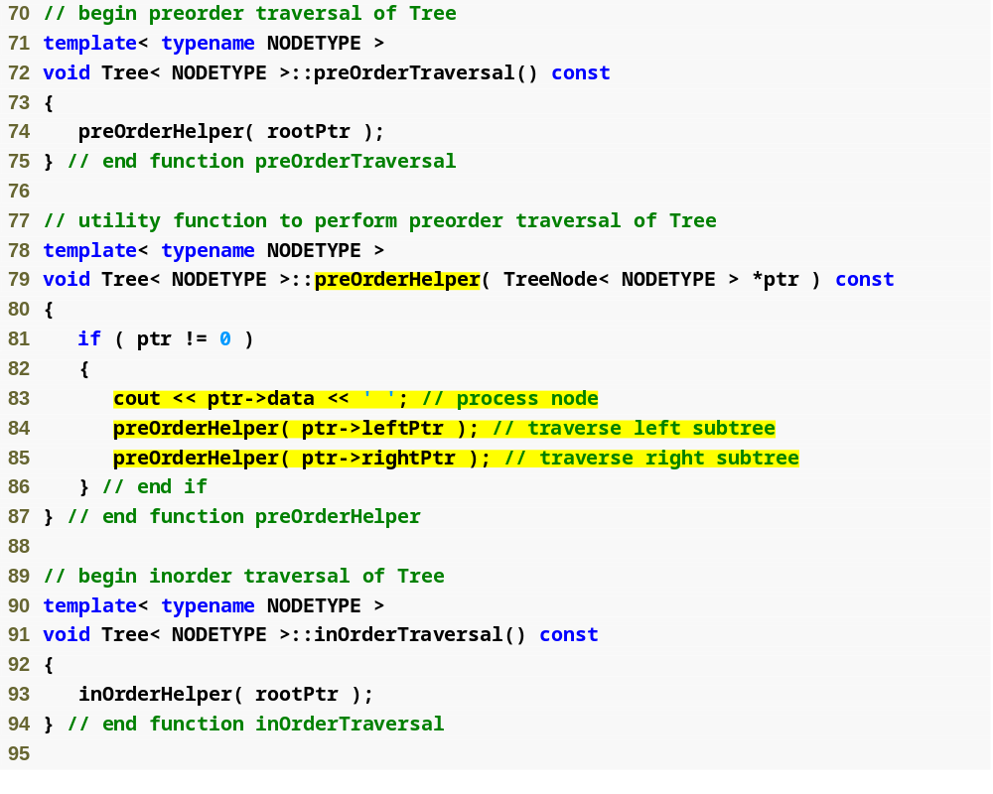
Outline
Tree.h
(4 of 6)
Process the value in the node, traverse the left subtree, traverse the right subtree

Slide 70
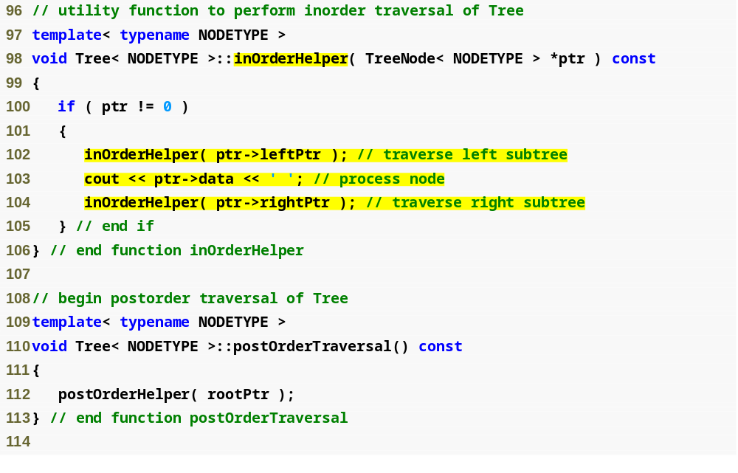
Outline
Tree.h
(5 of 6)
Traverse the left subtree, process the value in the node, traverse the right subtree

Slide 71
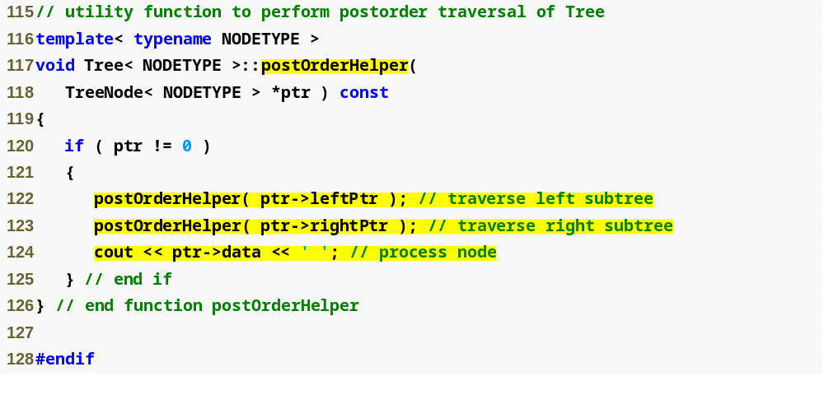
Outline
Tree.h
(6 of 6)
Traverse the left subtree, traverse the right subtree, process the value in the node

Slide 72
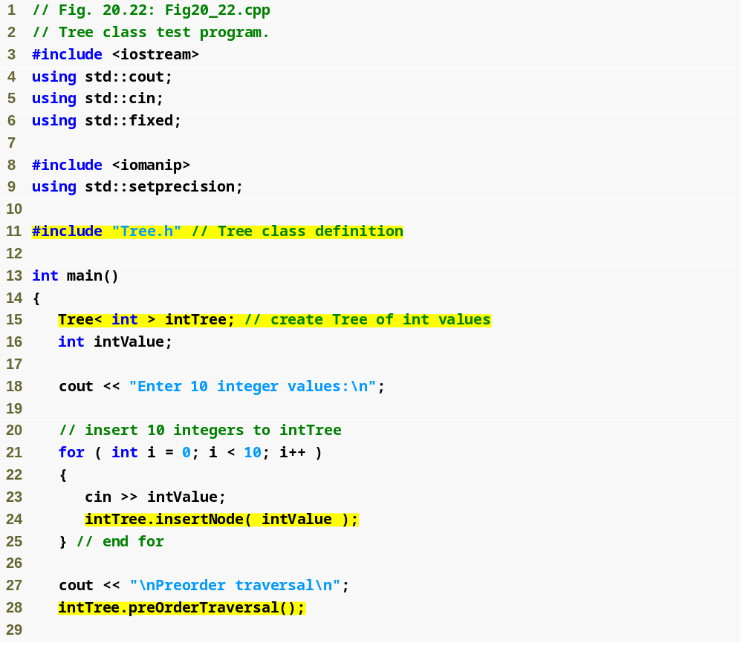
Outline
Fig20_22.cpp
(1 of 3)
Instantiate integer tree intTree of type Tree< int >
Insert int values into the binary tree
Perform traversal of intTree

Slide 73
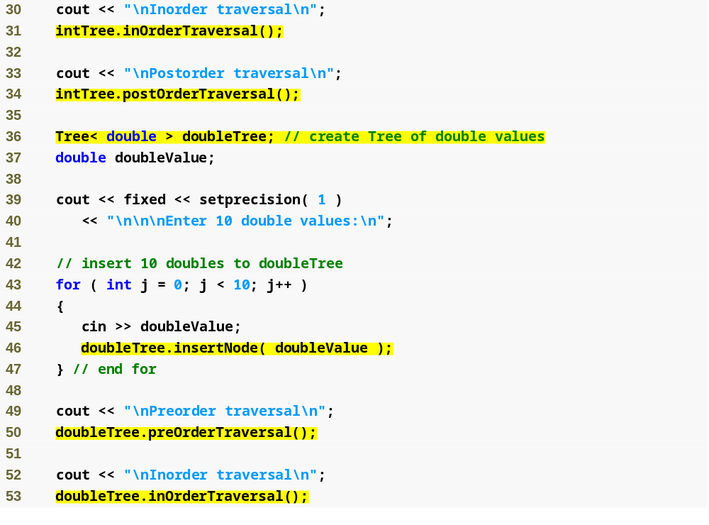
Outline
Fig20_22.cpp
(2 of 3)
Instantiate floating-point tree doubleTree of type Tree< double >
Insert double values into the binary tree
Perform traversal of doubleTree

Slide 74
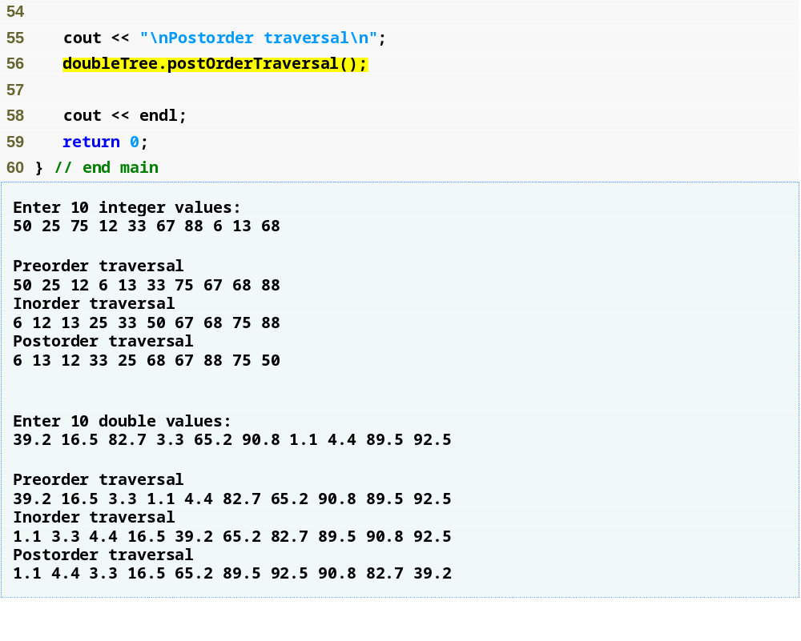
Outline
Fig20_22.cpp
(3 of 3)

Slide 75

Fig. 20.23 | A binary search tree.

Slide 76
20.7 Trees (Cont.)
Tree (Cont.)
  Applications of binary search trees
    Duplicate elimination
      Inserting duplicate will follow same path as original
      Duplicate can be discarded when compared with orignal
    Searching (in a balanced binary search tree)
      Has O(log n) runtime
        Each comparison of a node to search key eliminates half the nodes
        Maximum of log₂ n comparisons are required
    Sorting (binary tree sort)
      Inorder traversal of a binary search tree results in processing the values in ascending order

